Slide 1


AI MOTION DETECTION SYSTEM
Presented by Mohammad Al-Hriry

Slide 2
AI Motion Detection System
Real-time Activity Classification System
3-Bit Core Members
Motion Sense AI Competition
Mohammad Al-Hriry
MathWorks & IEEE ComSoc
Omar Elmahrouk
Ra’ad Hawamdeh

Slide 3
The Challenge of Activity Monitoring
Manual activity tracking is time-consuming and inaccurate.
Current solutions often require specialized hardware
Limited real-time feedback in existing applications
Growing importance of remote health monitoring solutions

Slide 4
Smartphone-Based Activity Recognition
Uses built-in smartphone sensors (no extra hardware)
Real-time classification of 4 activities:
Sitting, Standing, Walking, Lying down
Web-based dashboard for instant feedback
Machine learning-powered accuracy
Goal tracking and progress monitoring

Slide 5
System Architecture
How it works:
Feature
Extraction:
Statistical
Features
Data Collection:
Phyphox App
(Sensors)
Machine Learning:
Random Forest
Classifier
Visualization:
Web Dashboard
(Charts & Reports)

Slide 6
Data Pipeline
Data Collection: IMU sensors (accelerometer + gyroscope)
Data Processing: Sliding window technique (100 samples/window)
Feature Extraction: 30 statistical features (mean, std, min, max, energy)
Model Training: Random Forest classifier
Real-time Prediction: Activity classification every 2 seconds
Visualization: Interactive dashboard with charts and reports

Slide 7
Machine Learning Model
Model
Performance Metrics:
Random Forest (ensemble method)
Input: 30 features from IMU data
Output: 4 activity classes
Training Data: 167,402 sensor readings
Window Size:100 samples(2 seconds at 50Hz)
Step Size: 50 samples (1 second overlap)
Overall Accuracy: 99.7%
Precision: 99-100% across all classes
Recall: 99-100% across all classes
F1-Score: 99-100% across all classes

Slide 8
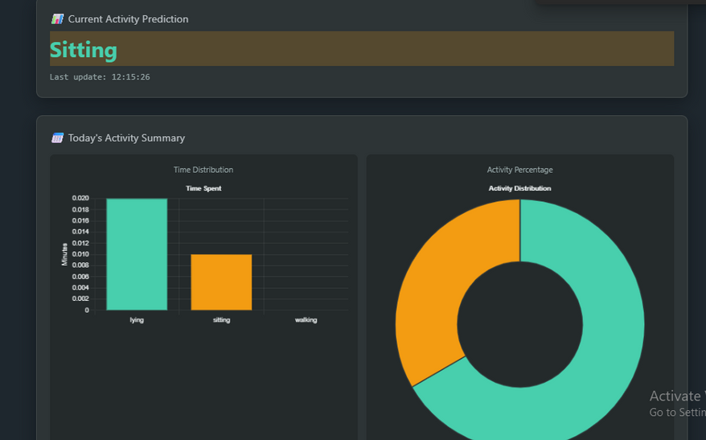
Technical Implementation
Backend (Python/Flask):
Real-time data processing from Phyphox
Feature extraction and ML prediction
Frontend (HTML/CSS/JS):
Responsive dashboard design
Chart.js for data visualization

Slide 9
Key Features
What Makes Our System Stand Out
Real-time Classification: Instant activity recognition
Interactive Dashboard: Beautiful visualizations
Current activity display
Historical charts (bar and pie)
Timeline view of activities
Goal Tracking: Daily walking goal with progress indicator
Responsive Design: Works on desktop and mobile devices
No Special Hardware: Uses only smartphone sensors

Slide 10
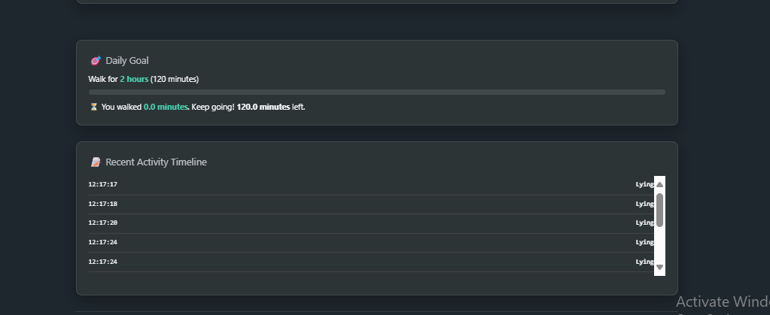
Results & Performance
Quantitative Results:
99.7% classification accuracy
Real-time prediction (< 100ms processing time)
Handles 50Hz sensor data seamlessly
Qualitative Benefits:
User-friendly interface
Immediate feedback on activities
Motivational goal tracking
Historical progress visualization

Slide 11
Practical Uses of Our System
Healthcare: Patient activity monitoring
Fitness: Workout tracking and goal setting
Research: Human activity studies and data collection
Sports: Training activity classification

Slide 12
Future Enhancements
What's Next for Our Project
Short-term Improvements:
Add more activity types (running, cycling, stairs)
Implement user authentication
Mobile app version
Long-term Vision:
Predictive health insights
AI-powered recommendations
Multi-user tracking and comparisons
Advanced analytics and reporting
Cloud storage for data persistence

Slide 13
Thank You
For your attention
We welcome your questions and feedback
Email: mohammademad815@gmail.com

